Slide 1
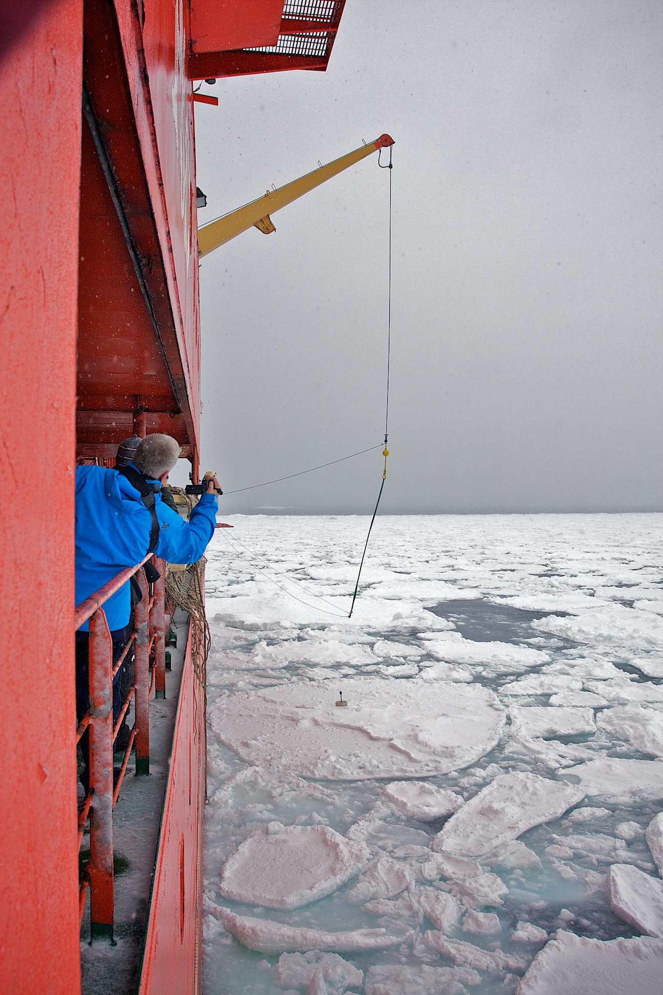





Storm-induced sea-ice breakup
and the implications for ice extent
A. L. Kohout ª, M. J. M. Williams ^{b}, S. M. Dean ^{b}, M. H. Meylan ^{c}
ª National Institute for Water and Atmospheric Research, Christchurch, New Zealand; alison.kohout@niwa.co.nz ^{b} National Institute for Water and Atmospheric Research, Wellington, New Zealand ^{c} The University of Newcastle, Newcastle, Australia
Overview of observations
Wave sensor tracks
What impact will the expected increase in wave heights in polar regions have on sea-ice?
62°S
New Antarctic waves-in-ice observations capturing both calm and large wave events.
124°E
128°E
Figure 1: The large round markers (beginning) and square markers (end) show the track of each sensor. The small round markers indicate positions on particular dates. Mean sea-ice concentration from satellite imagery between 23/09/12 and 02/11/12 is shown with white as 100% sea-ice concentration and blue as open water.
The decay of large waves in sea-ice does not follow previously assumed theory.
Figure 2: Significant wave heights (solid) and distance from ice edge (dashed) of the red and blue sensors shown in Figure 1.
Ice-breaking potential
Significant wave height decay rates
Large waves maintain floe breaking potential hundreds of kilometres from the ice edge.
Large waves
Retreat and expansion of the sea-ice edge correlate with mean significant wave height increases and decreases, respectively.
dH_{s}/dx
Small waves
We capture the spatial variability in sea-ice trends found in the Ross and Amundsen – Bellingshausen seas.
Figure 4: Given the significant wave height (H_{s}) at the ice edge, highlighted are conditions where breaking will not occur (yellow), may occur (orange) and is likely to occur (red). The long-dashed line is the likely breaking limit calculated using the attenuation coefficient observed in the Arctic for small-amplitude waves with a 12-s period. This is extrapolated using small-amplitude wave theory (short-dashed). The markers show ice floe breakup events during this experiment (dot) and during a large-wave event in the Arctic (cross).
H_{s}
Figure 3: The significant wave height (H_{s}) decay rates of sensors further than 100 km from the ice edge are presented via box plots with Hs bins. Blue markers show outliers. The dashed black line shows the decay that would be expected if small-amplitude wave theory held for large waves.
Our observations show that large waves travelling through sea-ice maintain more energy than expected,
Trends in sea-ice extent and significant wave height
Ice decay season r = -0.70
implying they play a more prominent role in sea-ice breakup and retreat than previously assumed.
Ice growth season r = -0.79
Photo: Rob Johnson
Acknowledgments
We thank Inprod Pty Ltd for instrument design and construction; M. Doble, V. Squire and T. Haskell for contributions toward instrument design; T. Toyota for the provision of ice floe size and ice thickness data; the captain and crew of RSV Aurora Australis and the second Sea Ice Physics and Ecosystem Experiment (SIPEX II) for their assistance in deploying the waves-in-ice instruments; and V. Squire, T. Toyota, L. Bennetts and T. Williams for contributions toward interpretation and editing. The work was funded by a New Zealand Foundation of Research Science and Technology Postdoctoral award to A.L.K.; the Marsden Fund Council, administered by the Royal Society of New Zealand; NIWA, through core funding under the National Climate Centre Climate Systems programme; the Antarctic Climate and Ecosystems Cooperative Research Centre; and Australian Antarctic Science project 4073.
Figure 5: The observed trend in the location of the ice edge (red) and the simulated trend in the significant wave height (blue) between 1997 and 2009 are shown as functions of longitude. a Averaged trends for the ice decay season (September to February). b The averaged trends during the ice growth season (March to August).
Deployment of a waves-in-ice sensor via Aurora Australis’ aft crane.

